Slide 1
Extending GPU Ray-Tracing Units for Hierarchical Search Acceleration
Aaron Barnes, Fangjia Shen, Timothy G. Rogers
MICRO 2024

Slide 2
Hierarchical Search is important for GPUs
Dedicated GPU HW Unit
Database Queries
Ray-Tracing
Recommendation Systems

Slide 3
Hierarchical Search Data Structures
Dedicated GPU HW Unit
B-Tree
Bounding Volume Hierarchy
Hierarchical Graph
Database Queries
(1 dimension)
Ray-Tracing
(3 dimensions)
Approximate Nearest Neighbors / Vector Search
(N+ dimensions)

Slide 4
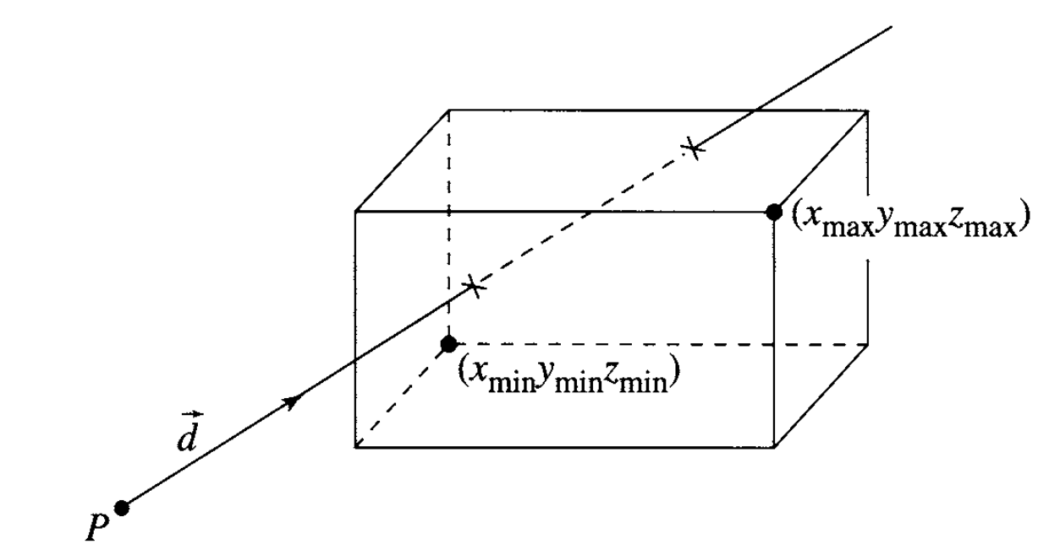
A Common Problem
Hierarchical Search Applications on GPUs are limited by extensive branching and expensive computation at each node during traversal
Poor SIMT efficiency and memory utilization
Expensive traversal Operations
A
B
C
D
Time
AABB image source: [Schneider et al.] in Geometric Tools for Computer Graphics, 2003

Slide 5
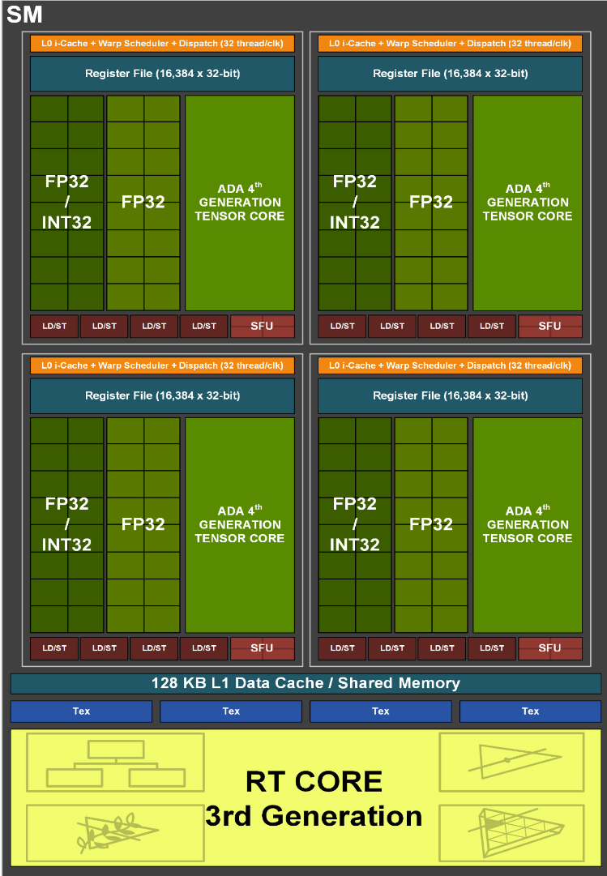
Key Insight: RT Unit already addresses these issues!

Slide 6
What benefit does RT Unit Provide?
Ray-Tracing (RT) Unit Advantages
RT Unit Limitations
Loads data from memory and performs several operations a single CISC-like instruction
Fixed function logic to compute intersection operations without writing back intermediate results
Improves throughput in highly thread-divergent workloads
Accessible only through rigid graphics APIs like Optix, Vulkan, or DirectX
Underlying data structure is hidden from programmer and hardware is not compatible with non-BVH structures
Limited to a strict subset of data types and 3-dimensions

Slide 7
Solution: Hierarchical Search Unit (HSU)
Flexible programming interface for hardware accelerated GPU search
New instructions to support a small set of common search operations
Maximize reuse of existing RT unit functional units while extending the hardware to perform high-dimension distance calculations and key comparisons

Slide 8
Outline
Motivation
Introduction to Hierarchical Search Unit (HSU)
Background
Ray Tracing
Bounding Volume Hierarchies (BVH)
Design
Programming Interface
Hardware
Results
Conclusion

Slide 9
The Ray Tracing Problem
Camera
Pixel Grid
3-D Mesh
Ray
$$r\left(t\right)=o+td$$
[t₀, t_{f}]

Slide 10
Bounding Volume Hierarchy (BVH)

Slide 11
Programming Interface: Baseline RT Unit
Ray Generation
TraceRay()
Program (RG)

Slide 12
Programming Interface: Baseline RT Unit
Ray Generation
TraceRay()
AS traversal &
Program (RG)
ray
-
AABB
intersection test
Entered a Leaf Node
Intersection
Program (IS)

Slide 13
Programming Interface: Baseline RT Unit
Ray Generation
TraceRay()
AS traversal &
Program (RG)
ray
-
AABB
No
intersection test
Entered a Leaf Node
Ray
Intersection
-
Primitive
Intersection?
Program (IS)
Any
-
Yes
Hit program
(AH)

Slide 14
Programming Interface: Baseline RT Unit
Ray Generation
TraceRay()
AS traversal &
Program (RG)
ray
-
AABB
Hit Occurred?
No
intersection test
Entered a Leaf Node
Yes
Ray
Intersection
Closest Hit
No
-
Primitive
Intersection?
Program (IS)
Program (CH)
Any
-
Yes
Hit program
Miss Program
(AH)

Slide 15
Programming Interface: HSU
ISA compatible with existing RT graphics APIs
Library APIs for creating and searching different data structures

Slide 16
Instruction Set
Baseline RT Unit:
RAY_INTERSECT
Calculates the intersection of 1 ray and one triangle
Calculates the intersection of 1 ray and four boxes (sorted by closest hit)
HSU
POINT_EUCLID
Calculates N-dimension squared Euclidean distance
POINT_ANGULAR
Calculates dot product and squared norm to partially compute angular distance
KEY_COMPARE
Performs a key comparison against up to 36 values per thread

Slide 17
Hardware: Baseline Ray Tracing Unit
Streaming Multiprocessor (SM)
Scheduler
Scheduler
Reg File
Reg File
Exec Units
Exec Units
LDST Unit
RT Unit
L1D Cache
Interconnect To Mem Hierarchy

Slide 18
Hardware: Baseline Ray Tracing Unit
Ray Tracing Unit
Warp Buffer
Entry Layout
Datapath Scheduler
Active Mask
Valid Mask
Unified Single-Lane Datapath Pipeline
Ray Data
Node Data or Address
Ray Data
Ray Data
Ray-Triangle
Ray-Box
Streaming Multiprocessor (SM)
Mem Access FIFO
Scheduler
Scheduler
Reg File
Reg File
Exec Units
Exec Units
LDST Unit
RT Unit
Mem Response FIFO
L1D Cache
Interconnect To Mem Hierarchy
32-Wide SIMD
Result
Single Lane Result
Result Buffer

Slide 19
Hardware: Baseline Ray Tracing Unit
Ray-Box
Ray-Tri
RT Unit
Warp Buffer
translate box to ray origin
translate tri to ray origin
Entry Layout
Datapath Scheduler
Active Mask
Valid Mask
compute intervals
Shear/scale vertices
Ray Data
Node Data or Address
Unified Single-Lane Datapath Pipeline
Ray Data
Ray Data
Ray-Triangle
Ray-Box
Mem Access FIFO
tmin / tmax calc
Calc scaled bary. coord.
Mem Response FIFO
32-Wide SIMD
Result
Result Buffer
Single Lane Result
Hit = tmin <= tmax
Calc determinant
Sort closest hit
Calc hit distance

Slide 20
Hardware: Hierarchical Search Unit (HSU)
Ray-Box
Ray-Tri
Euclid Distance
Angular Distance
Key Compare
RT Unit
Warp Buffer
translate box to ray origin
translate tri to ray origin
16-wide subtraction
2x 8-wide mul
36-wide comparator
Entry Layout
Datapath Scheduler
Active Mask
Valid Mask
compute intervals
Shear/scale vertices
16-wide mul.
Adder tree reduction
Ray/Query Data
Node Data or Address
Unified Single-Lane Datapath Pipeline
Ray Data
Ray Data
Ray-Triangle
Ray-Box
Euclidean
Angular
Key Compare
Mem Access FIFO
tmin / tmax calc
Calc scaled bary. coord.
Adder tree reduction
Accumulate Dist and Norm Sums
Mem Response FIFO
32-Wide SIMD
Result
Result Buffer
Single Lane Result
Hit = tmin <= tmax
Calc determinant
Accumulate Sum
Sort closest hit
Calc hit distance

Slide 21
Single-Lane Scheduling Example
Triangle Node
Box Node
Empty Lane
Warp Buffer
Warp 2
Warp 1
Warp 0
CYCLE 0
Single-Lane Unified Pipeline
Stage 0
Stage 1
Stage 2
SM Register File
Result Buffer
[Saleh et al. 2019/0197761A1]

Slide 22
Single-Lane Scheduling Example
Triangle Node
Box Node
Empty Lane
Warp Buffer
Warp 2
Warp 1
Warp 0
CYCLE 1
Single-Lane Unified Pipeline
Stage 0
Stage 1
Stage 2
SM Register File
Result Buffer
[Saleh et al. 2019/0197761A1]

Slide 23
Single-Lane Scheduling Example
Triangle Node
Box Node
Empty Lane
Warp Buffer
Warp 2
Warp 1
Warp 0
CYCLE 2
Single-Lane Unified Pipeline
Stage 0
Stage 1
Stage 2
SM Register File
Result Buffer
[Saleh et al. 2019/0197761A1]

Slide 24
Single-Lane Scheduling Example
Triangle Node
Box Node
Empty Lane
Warp Buffer
Warp 2
Warp 1
Warp 0
CYCLE 3
Single-Lane Unified Pipeline
Stage 0
Stage 1
Stage 2
SM Register File
Result Buffer
[Saleh et al. 2019/0197761A1]

Slide 25
Single-Lane Scheduling Example
Triangle Node
Box Node
Empty Lane
Warp Buffer
Warp 2
Warp 1
CYCLE 4
Single-Lane Unified Pipeline
Stage 0
Stage 1
Stage 2
SM Register File
Result Buffer
Warp 0
[Saleh et al. 2019/0197761A1]

Slide 26
Single-Lane Scheduling Example
Triangle Node
Box Node
Empty Lane
Warp Buffer
Warp 2
Warp 1
CYCLE 5
Single-Lane Unified Pipeline
Stage 0
Stage 1
Stage 2
SM Register File
Result Buffer
Warp 0
[Saleh et al. 2019/0197761A1]

Slide 27
Single-Lane Scheduling Example
Triangle Node
Box Node
Empty Lane
Warp Buffer
Warp 2
Warp 1
CYCLE 6
Single-Lane Unified Pipeline
Stage 0
Stage 1
Stage 2
SM Register File
Result Buffer
Warp 0
[Saleh et al. 2019/0197761A1]

Slide 28
Single-Lane Scheduling Example
Triangle Node
Box Node
Empty Lane
Warp Buffer
Warp 2
Warp 1
CYCLE 7
Single-Lane Unified Pipeline
Stage 0
Stage 1
Stage 2
SM Register File
Warp 0 Result Written to RF
Result Buffer
Warp 1
[Saleh et al. 2019/0197761A1]

Slide 29
Single-Lane Scheduling : HSU
POINT_EUCLID Data
Empty Lane
Warp Buffer
Warp 2
Warp 1
Warp 0
CYCLE 0
Single-Lane Unified Pipeline
Stage 0
Stage 1
Stage 2
Scheduling is the same as the Baseline! The only difference is the data retrieved from memory contains candidate vectors instead of boxes/triangles.
HSU modifies the Unified pipeline to support additional instructions.
SM Register File
Result Buffer

Slide 30
Unified Pipeline Example
CYCLE 0
Operation Performed
Stage 1
Ray-Box operation
Pipeline Registers 0
// Translate 4 AABB relative to ray origin
box0.x_min = box0.x_min - ray.origin.x;
box0.y_min = box0.y_min - ray.origin.y;
box0.z_min = box0.z_min - ray.origin.z;
box0.x_max = box0.x_max - ray.origin.x;
box0.y_max = box0.y_max - ray.origin.y;
box0.z_max = box0.z_max - ray.origin.z;
…
box3.z_max = box3.zmax – ray.origin.z;
(24 Adds Required)
24 Enable / Disable
ADD 4
ADD 4
ADD 4
ADD 4
ADD 4
ADD 4
Multiplexers
Pipeline Registers 1
Stage 2
24 Enable / Disable
MUL 4
MUL 4
MUL 4
MUL 4
MUL 4
MUL 4
Multiplexers
Pipeline Registers 2
Stage 3

Slide 31
Unified Pipeline Example
CYCLE 1
Operation Performed
Stage 1
Point-Euclid operation
Pipeline Registers 0
// Calculate subtraction of candidate vector c and query q for 16 // dimensions
Res0 = q0 – c0;
Res1 = q1 – c1;
…
Res15 = q15 – c15;
(16 Adds Required)
24 Enable / Disable
ADD 4
ADD 4
ADD 4
ADD 4
ADD 4
ADD 4
Multiplexers
Pipeline Registers 1
Stage 2
Ray-Box operation
// Compute Time intervals of ray intersecting 3 planes for each // box
T_min_x0 = box0.x_min * ray.inv.x;
T_max_x0 = box0.x_max * ray.inv.x;
…
T_max_z3 = box3.z_max * ray.inv.z;
(24 Multiplies Required)
24 Enable / Disable
MUL 4
MUL 4
MUL 4
MUL 4
MUL 4
MUL 4
Multiplexers
Pipeline Registers 2
Stage 3

Slide 32
Unified Pipeline Example
CYCLE 2
Operation Performed
Stage 1
Point-Angular operation
Pipeline Registers 0
// No computation this stage, all Functional units disabled and
// data is passed unchanged to next stage
(0 Adds Required)
24 Enable / Disable
ADD 4
ADD 4
ADD 4
ADD 4
ADD 4
ADD 4
Multiplexers
Pipeline Registers 1
Stage 2
Point Euclid operation
// Intermediate results are squared
S0 = Res0 * Res0;
S1 = Res1 * Res1;
…
S15 = Res15 * Res15;
(16 Multiplies Required)
24 Enable / Disable
MUL 4
MUL 4
MUL 4
MUL 4
MUL 4
MUL 4
Multiplexers
Pipeline Registers 2
Stage 3
Ray-Box operation

Slide 33
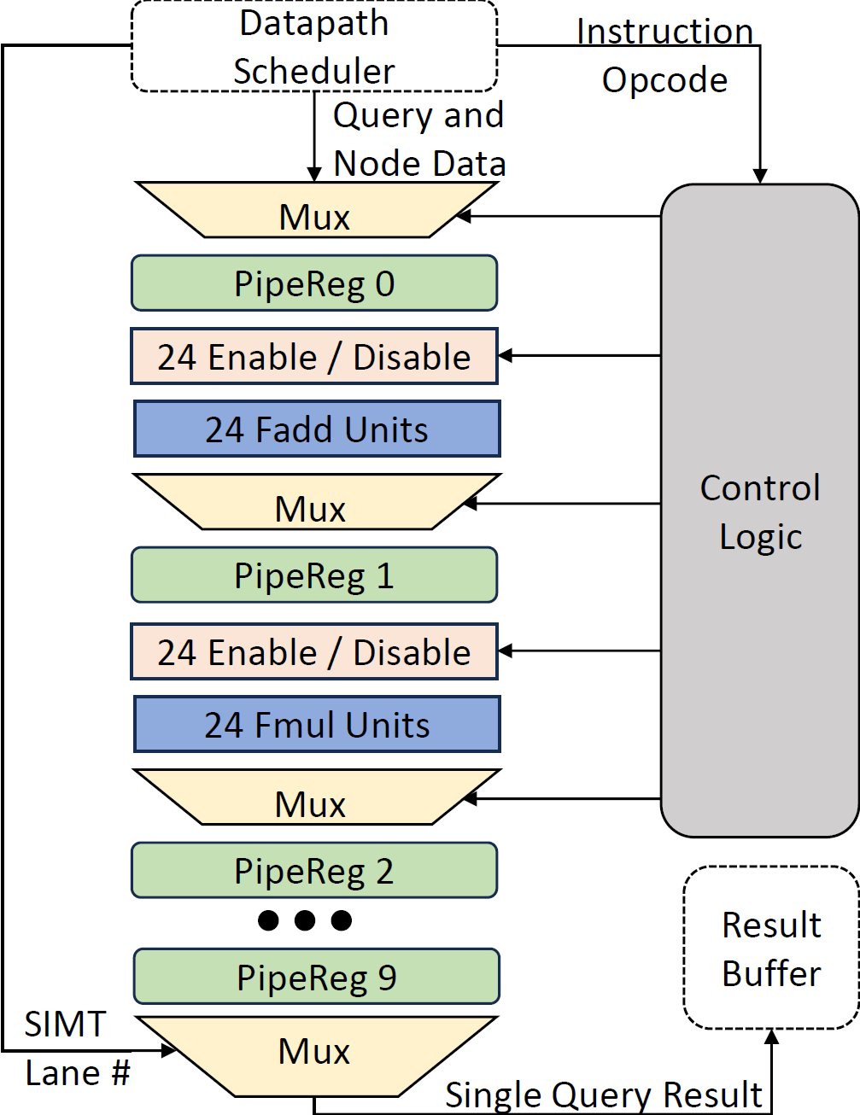
Unified Pipeline : FU Reuse
Stage | Ray-Box | Ray-Triangle | Euclidean | Angular
1 | 24 Adds | 9 Adds | 16 Adds
2 | 24 Muls | 9 Muls | 16 Muls | 16 Muls
3 | 36 Cmps | 6 Adds | 8 Adds | 8 Adds
4 | 4 Cmps | 6 Muls
5 |  | 3 Adds | 4 Adds | 4 Adds
6 |  | 3 Muls
7 |  | 2 Adds | 2 Adds | 2 Adds
8 |  | 2 Adds | 1 Add | 2 Adds (accum)
9 | 2 Quadsort | 5 Cmp | 1 Add (accum)

Slide 34
Outline
Motivation
Introduction to Hierarchical Search Unit (HSU)
Background
Ray Tracing
Bounding Volume Hierarchies (BVH)
Design
Programming Interface
Hardware
Results
Conclusion

Slide 35
Methodology
Datasets:
GGNN – State of the art GPU Approximate Nearest Neighbors (ANN) implementation with high dimension datasets
FLANN – K-D tree 3-D ANN
BVH-NN – CUDA BVH ANN implementation similar to RTNN
B-Tree index search from Rodinia
Simulation Infrastructure
Accel-Sim + GPGPUSim 4.0 Volta model with RT Unit adapted from Vulkan-Sim to perform per-instruction intersection tests
Trace post processor to replace sequences of SASS instructions with HSU instructions
RTL Infrastructure for area and power
Details are in the paper

Slide 36
Summary Design Performance
1.25

Slide 37
Summary Design Performance
1.34
1.25

Slide 38
Summary Design Performance
1.34
1.25
1.16

Slide 39
Summary Design Performance
1.34
1.25
1.16
1.135

Slide 40
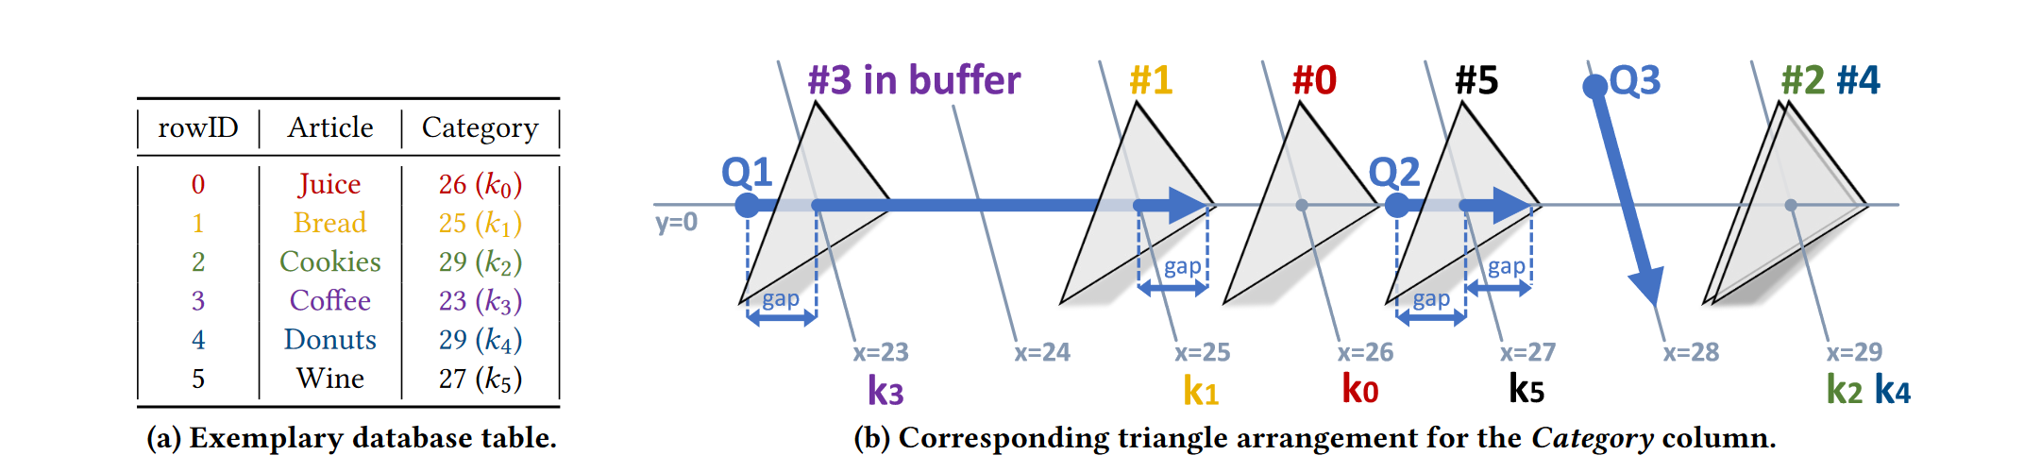
Related Work: RTIndex [J. Henneberg et al, VLDB ‘23]
HSU provides 36.6% speedup over RTIndex RT-Unit baseline, and uses 1/9 the memory for the key-store

Slide 41
Conclusion
Goals
Expand the RT Unit to accelerate a broader class of GPU search applications
Develop a simple HSU programming interface to allow workload-tailored data structures
Design
Reuses functional units and structure of the RT unit while providing additional utility for key GPU search workloads
Programming interface provides support for common GPU data structures with the flexibility to adapt to emerging workloads
Key Results
Improves state of the art GPU Approximate Nearest Neighbors 24.8% on average
Maintains equivalent baseline performance for existing raytracing applications
Improves key search by 36.6% over an algorithm using only software to execute on the RT Unit

Slide 42
Backup Slides

Slide 43
Proportion of non-RT V100 GPU applications that can be accelerated with HSU operations

Slide 44
Roofline Analysis of HSU

Slide 45
Datapath Normalized Area and Dynamic Power

Slide 46
Speedup of HSU at Different Datapath Widths (Euclidean)

Slide 47
HSU L1D Cache Accesses normalized to non-RT Baseline

Slide 48
Speedup of HSU at different Warp Buffer sizes

Slide 49
HSU L1D Cache Miss Rate

Slide 50
Memory Row Locality

