Slide 1
Mitigating GPU Core Partitioning Performance Effects
Aaron Barnes, Fangjia Shen, Timothy G. Rogers
Purdue University
HPCA 2023
2/27/2023

Slide 2
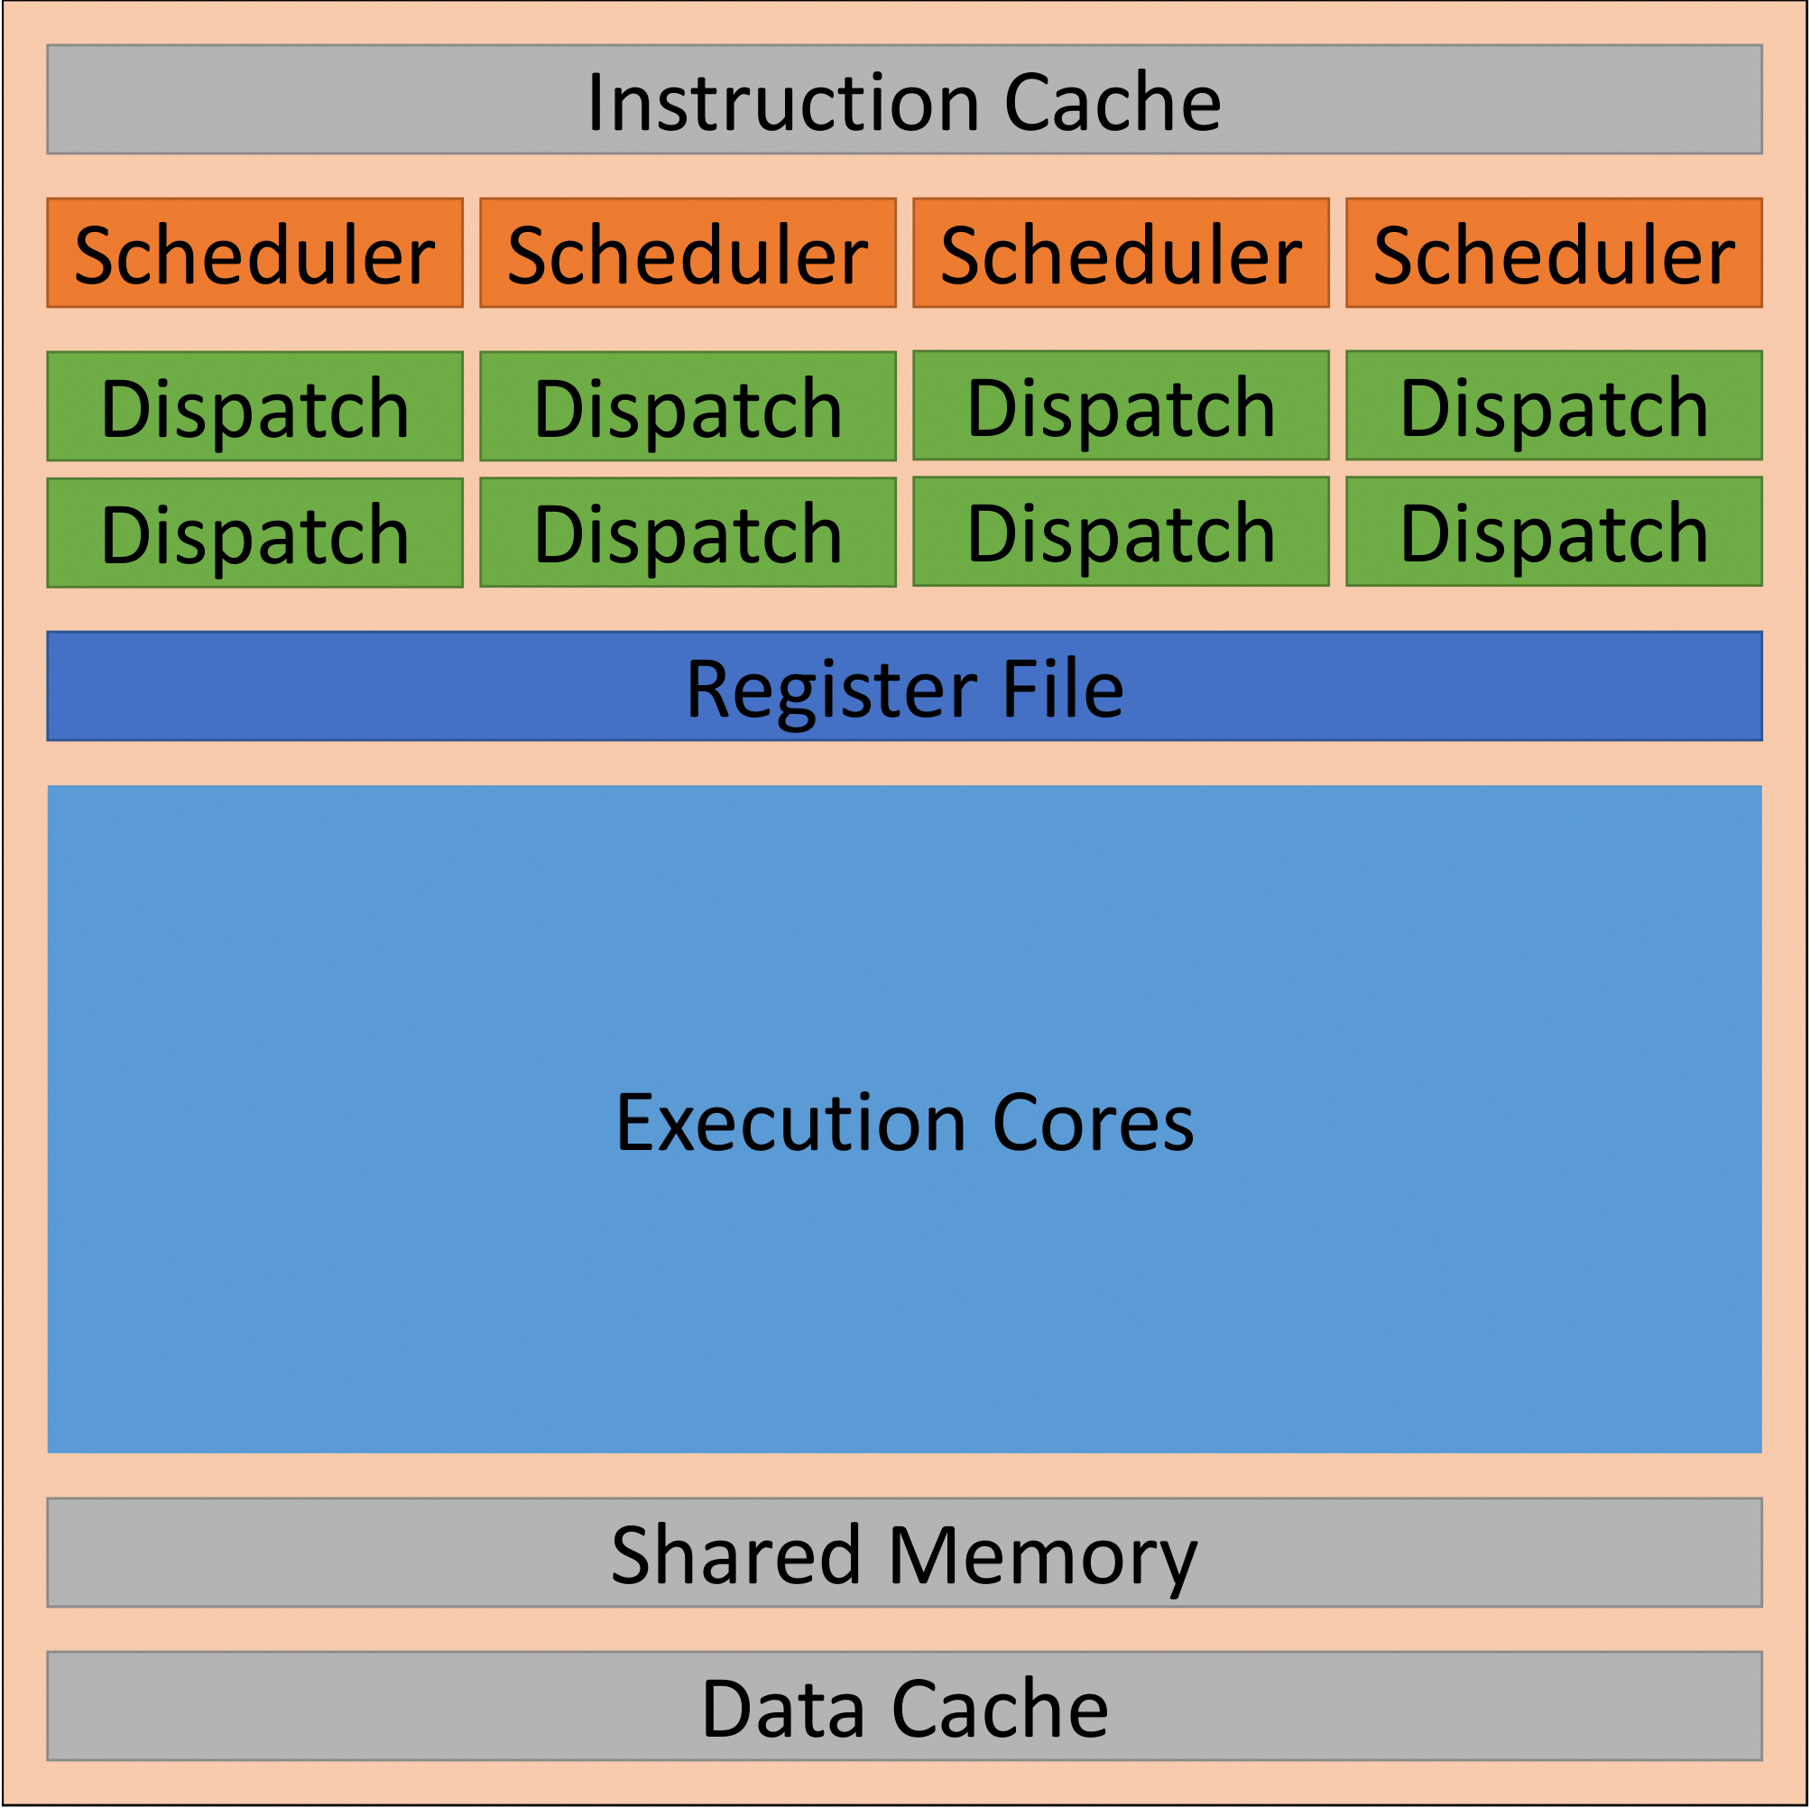
Two Generations of SM Architectures
Kepler (2012)

Slide 3
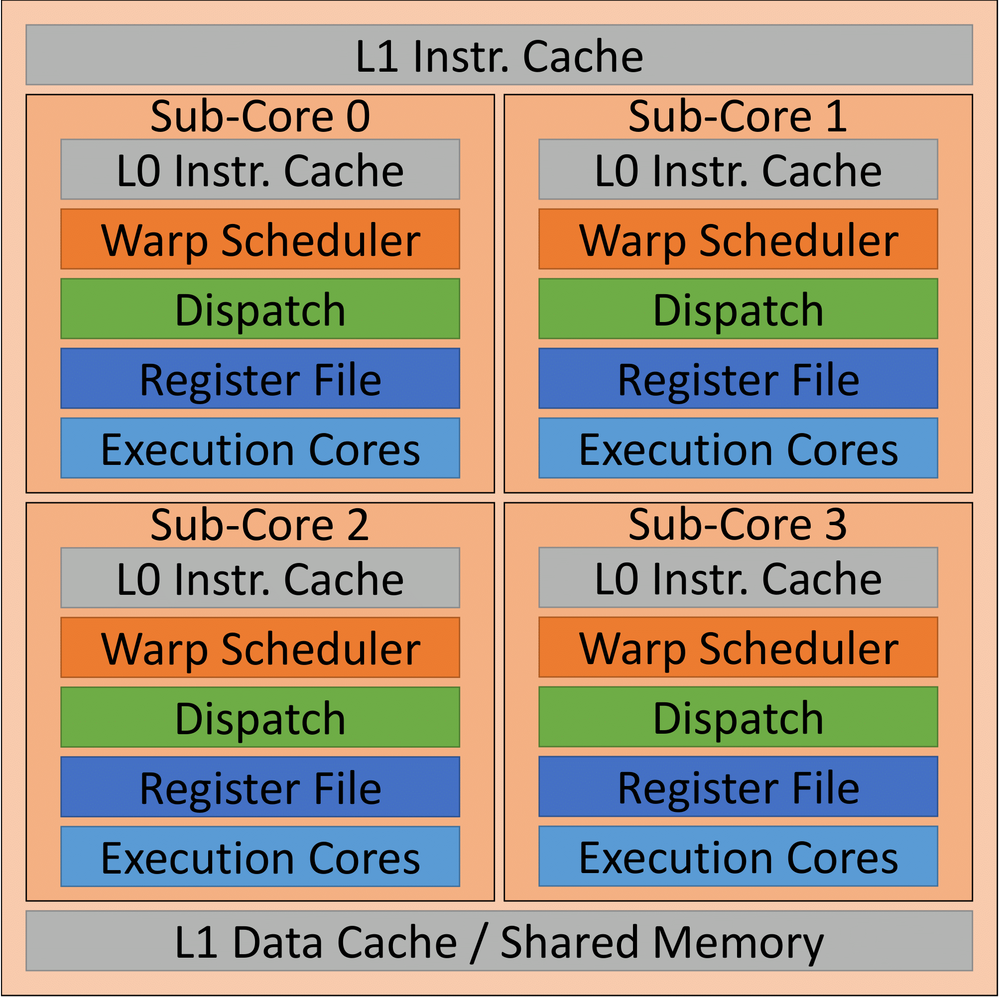
Two Generations of SM Architectures
Kepler (2012)
Hopper
(2022)

Slide 4
Two Generations of SM Architectures
1. Partitioned Register files have fewer banks and Collector Units (CUs) per thread
Kepler (2012)
Hopper
(2022)

Slide 5
Two Generations of SM Architectures
2. Warp Scheduler can only issue instructions to Execution Units in the same sub-core, imbalances cause under-utilization
Kepler (2012)
Hopper
(2022)

Slide 6
SM Register File Banks
Warp Scheduler
Warp Scheduler
Warp Scheduler
Warp Scheduler
Bank 0
Bank 1
Bank 2
Bank 3
Bank 4
Bank 5
Bank 6
Bank 7

Slide 7
SM Register File Banks
Warp Scheduler
Warp Scheduler
Warp Scheduler
Warp Scheduler
Bank 0
Bank 1
Bank 2
Bank 3
Bank 4
Bank 5
Bank 6
Bank 7

Slide 8
SM Register File Banks
Warp Scheduler
Warp Scheduler
Warp Scheduler
Warp Scheduler
Bank 0
Bank 1
Bank 2
Bank 3
Bank 4
Bank 5
Bank 6
Bank 7
# of Register Banks and Execution Units Stays the Same!

Slide 9
Hypothetical Fully-Connected SM

Slide 10
Hypothetical Fully-Connected SM

Slide 11
Hypothetical Fully-Connected SM

Slide 12
Outline
Background and Motivation
Register Bank Aware (RBA) Warp Scheduling
Hashed Sub-core Warp Assignment
Evaluation and Conclusion

Slide 13
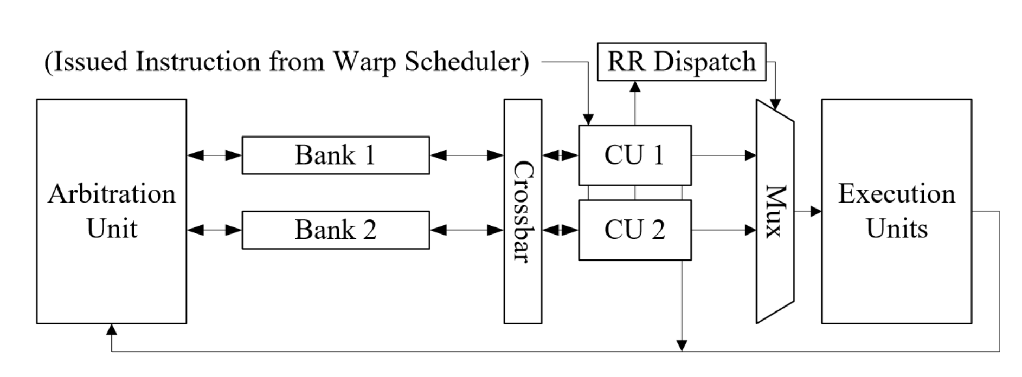
The Operand Collector
Each Collector Unit (CU) buffers one warp instruction
Instructions from other warps used to hide bank conflicts

Slide 14
Simple Operand Collector Example
// Thread block Code
i0: add r0 r2 r4
i1: fma r1 r3 r4 r5

Slide 15
Simple Operand Collector Example
// Thread block Code
i0: add r0 r2 r4
i1: fma r1 r3 r4 r5
W0:i0: add r0 r2 r4
W0:i1: fma r1 r3 r4 r5
W1:i0: add r0 r2 r4
W1:i1: fma r1 r3 r4 r5
W2:i0: add r0 r2 r4
W2:i1: fma r1 r3 r4 r5

Slide 16
Simple Operand Collector Example
// Thread block Code
i0: add r0 r2 r4
i1: fma r1 r3 r4 r5
W0:i0: add r0₀ r2₀ r4₀
W0:i1: fma r1₁ r4₀ r5₁ r1₁
W1:i0: add r0₁ r2₁ r4₁
W1:i1: fma r1₀ r4₁ r5₀ r1₀
W2:i0: add r0₀ r2₀ r4₀
W2:i1: fma r1₁ r4₀ r5₁ r1₁
Simple Register Swizzling:
bankID = (regID + WarpID) % 2

Slide 17
Simple Operand Collector Example
// Thread block Code
i0: add r0 r2 r4
i1: fma r1 r3 r4 r5
Collector Unit 0 (CU0)
Collector Unit 1 (CU1)
W0:i0: add r0₀ r2₀ r4₀
W0:i1: fma r1₁ r4₀ r5₁ r1₁
W1:i0: add r0₁ r2₁ r4₁
W1:i1: fma r1₀ r4₁ r5₀ r1₀
W2:i0: add r0₀ r2₀ r4₀
W2:i1: fma r1₁ r4₀ r5₁ r1₁
Simple Register Swizzling:
bankID = (regID + WarpID) % 2

Slide 18
Simple Operand Collector Example
// Thread block Code
i0: add r0 r2 r4
i1: fma r1 r3 r4 r5
CYCLE 0
Collector Unit 0 (CU0)
Collector Unit 1 (CU1)
W0:i0: add r0₀ r2₀ r4₀
W0:i1: fma r1₁ r4₀ r5₁ r1₁
W1:i0: add
r0₁ r2₁ r4₁
Warp Scheduler ISSUES
W1:i1: fma r1₀ r4₁ r5₀ r1₀
W2:i0: add r0₀ r2₀ r4₀
W2:i1: fma r1₁ r4₀ r5₁ r1₁
Simple Register Swizzling:
bankID = (regID + WarpID) % 2

Slide 19
Simple Operand Collector Example
// Thread block Code
i0: add r0 r2 r4
i1: fma r1 r3 r4 r5
CYCLE 1
Collector Unit 0 (CU0)
Collector Unit 1 (CU1)
W0:i0: add r0₀ r2₀ r4₀
W0:i1: fma r1₁ r4₀ r5₁ r1₁
W1:i0: add
r0₁ r2₁ r4₁
W2:i0: add
r0₀ r2₀ r4₀
W1:i1: fma r1₀ r4₁ r5₀ r1₀
Warp Scheduler ISSUES
W2:i1: fma r1₁ r4₀ r5₁ r1₁
Simple Register Swizzling:
bankID = (regID + WarpID) % 2

Slide 20
Simple Operand Collector Example
// Thread block Code
i0: add r0 r2 r4
i1: fma r1 r3 r4 r5
CYCLE 2
Warp Scheduler ISSUES
Collector Unit 0 (CU0)
Collector Unit 1 (CU1)
W0:i1: fma r1₁ r4₀ r5₁ r1₁
W0:i0: add
r0₀ r2₀ r4₀
W2:i0: add
r0₀ r2₀ r4₀
W1:i1: fma r1₀ r4₁ r5₀ r1₀
CU DISPATCH
W2:i1: fma r1₁ r4₀ r5₁ r1₁
To SIMD Execution Units:
W1:i0 add r0₁ r2₁ r4₁
Simple Register Swizzling:
bankID = (regID + WarpID) % 2

Slide 21
Simple Operand Collector Example
// Thread block Code
i0: add r0 r2 r4
i1: fma r1 r3 r4 r5
No free CU -> Warp Scheduler Stalls this cycle
CYCLE 3
Collector Unit 0 (CU0)
Collector Unit 1 (CU1)
W0:i1: fma r1₁ r4₀ r5₁ r1₁
W0:i0: add
r0₀ r2₀ r4₀
W2:i0: add
r0₀ r2₀ r4₀
Bank Conflict!
W1:i1: fma r1₀ r4₁ r5₀ r1₀
W2:i1: fma r1₁ r4₀ r5₁ r1₁
Simple Register Swizzling:
bankID = (regID + WarpID) % 2

Slide 22
Register Bank Aware Warp Scheduling
16 Entry
Warp PC Table
Warp Selection Logic
Issued Warp
Collector Units
(CUs)

Slide 23
Register Bank Aware Warp Scheduling
16 Entry
Warp PC Table
Warp Selection Logic
Issued Warp
Arbitration Unit
Collector Units
(CUs)
Register File Bank 0
Register File Bank 1
X-bar
Bank Read Requests

Slide 24
Register Bank Aware Warp Scheduling
16 Entry
Warp PC Table
Warp Selection Logic
Issued Warp
Arbitration Unit
Collector Units
(CUs)
Register File Bank 0
Register File Bank 1
X-bar
Bank Read Requests

Slide 25
Register Bank Aware Warp Scheduling
RBA Scoring
Logic
16 Entry
Warp PC Table
Warp Selection Logic
Issued Warp
Request Queue Lengths
Arbitration Unit
Collector Units
(CUs)
Register File Bank 0
Register File Bank 1
X-bar
Bank Read Requests

Slide 26
Register Bank Aware Warp Scheduling
RBA Scoring
Logic
16 Entry
Warp PC Table
Warp Selection Logic
Issued Warp
Request Queue Lengths
Arbitration Unit
Collector Units
(CUs)
Register File Bank 0
Register File Bank 1
X-bar
Bank Read Requests
Main Idea: Use feedback from the Collector Unit to improve Warp Scheduling

Slide 27
Outline
Background and Motivation
Register Bank Aware (RBA) Warp Scheduling
Hashed Sub-core Warp Assignment
Evaluation and Conclusion

Slide 28
How are warps assigned to sub-cores in HW?
PCIe Interface
Thread Block Scheduler
SM
SM
SM
SM
SM
SM
SM
SM
Kernel Launch
SM
SM
SM
SM
L2 Cache
SM
SM
SM
SM
HOST
SM
SM
SM
SM
SM
SM
SM
SM
GPU

Slide 29
How are warps assigned to sub-cores in HW?
PCIe Interface
Interconnect Arbiter
Thread Block Scheduler
Sub Core Scheduler
SM
SM
SM
SM
Sub-core 0
Sub-core 1
SM
SM
SM
SM
Kernel Launch
SM
SM
SM
SM
Sub-core 2
Sub-core 3
L2 Cache
SM
SM
SM
SM
HOST
SM
SM
SM
SM
Streaming Multiprocessor
SM
SM
SM
SM
GPU

Slide 30
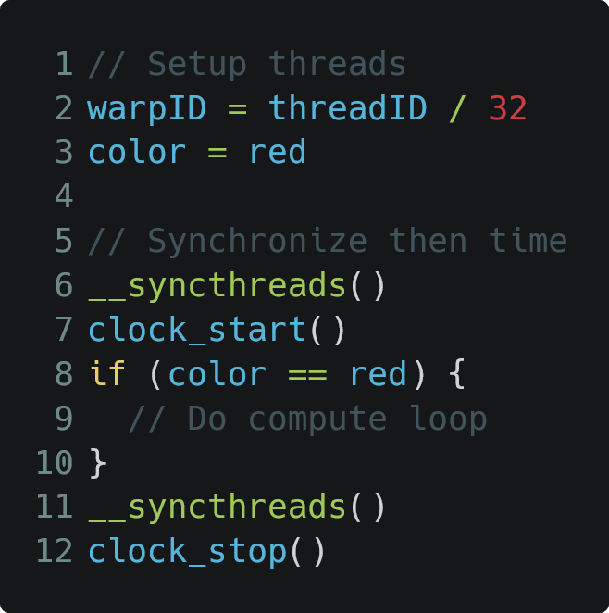
Sub-Core Assignment Microbenchmark
Thread Block (Baseline)
0
1
2
3
4
5
6
7
Sub-Cores

Slide 31
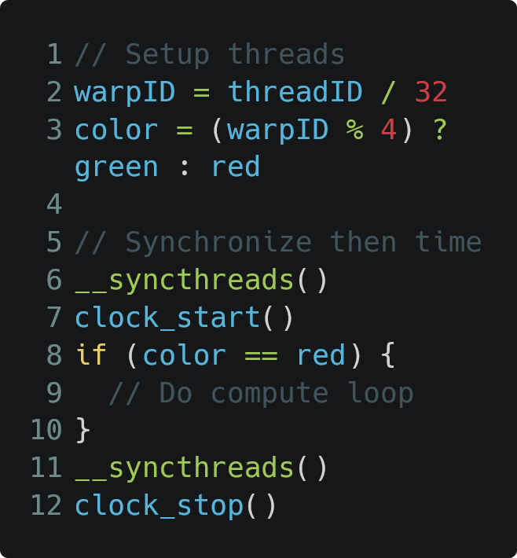
Sub-Core Assignment Microbenchmark
Thread Block (Unbalanced)
0
1
2
3
4
5
6
7
Thread Block (Baseline)
8
9
10
11
0
1
2
3
12
13
14
15
16
17
18
19
20
21
22
23
4
5
6
7
24
25
26
27
28
29
30
31
Sub-Cores
Sub-Cores

Slide 32
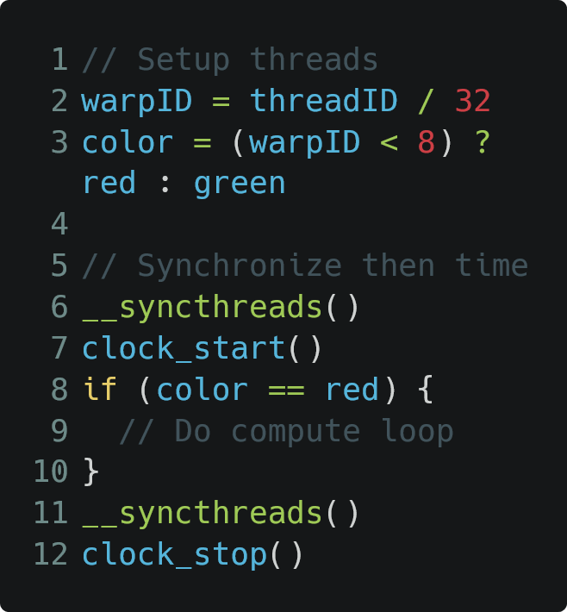
Sub-Core Assignment Microbenchmark
Thread Block (Unbalanced)
Thread Block (Balanced)
0
1
2
3
0
1
2
3
4
5
6
7
4
5
6
7
Thread Block (Baseline)
8
9
10
11
8
9
10
11
0
1
2
3
12
13
14
15
12
13
14
15
16
17
18
19
16
17
18
19
20
21
22
23
20
21
22
23
4
5
6
7
24
25
26
27
24
25
26
27
28
29
30
31
28
29
30
31
Sub-Cores
Sub-Cores
Sub-Cores

Slide 33
Warp Imbalance in Real Applications
A
B
C
D
Time
INTRA-warp divergence

Slide 34
Warp Imbalance in Real Applications
A
B
C
D
TB
TB
TB
W0
W0
W0
W1
W2
W2
W3
Time
Time
INTRA-warp divergence
INTER-warp divergence

Slide 35
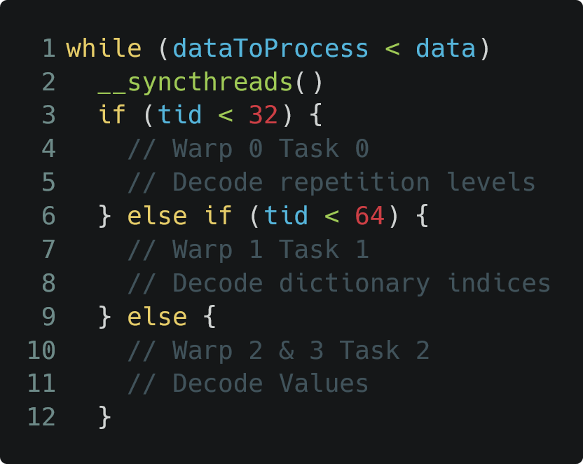
Warp Imbalance in Real Applications
A
B
C
D
TB
TB
TB
W0
W0
W0
W1
W2
W2
W3
Time
Time
INTRA-warp divergence
INTER-warp divergence
Warp Specialized Programming

Slide 36
Static Skewed Round Robin (SRR)
Replace the Round Warp PC multiplexer with a different static hashing function to avoid pathological imbalances
Sub-Core 0
Sub-Core 1
Thread Block
0
Sub-Core 2
Sub-Core 3
1
2
3
4
5
6
7
8
9
10
11
12
13
14
15
16
17
18
19
20
21
22
23
24
25
26
27
28
29
30
31

Slide 37
Static Skewed Round Robin (SRR)
Replace the Round Warp PC multiplexer with a different static hashing function to avoid pathological imbalances
Sub-Core 0
Sub-Core 1
0
1
Thread Block
0
Sub-Core 2
Sub-Core 3
1
2
3
4
5
6
7
2
3
8
9
10
11
12
13
14
15
16
17
18
19
20
21
22
23
24
25
26
27
28
29
30
31

Slide 38
Static Skewed Round Robin (SRR)
Replace the Round Warp PC multiplexer with a different static hashing function to avoid pathological imbalances
Sub-Core 0
Sub-Core 1
0
7
1
4
Thread Block
0
Sub-Core 2
Sub-Core 3
1
2
3
4
5
6
7
2
5
3
6
8
9
10
11
12
13
14
15
16
17
18
19
20
21
22
23
24
25
26
27
28
29
30
31

Slide 39
Random Shuffle
Random permutation selected to order warps assigned four each time
Sub-Core 0
Sub-Core 1
Thread Block
0
Sub-Core 2
Sub-Core 3
1
2
3
4
5
6
7
8
9
10
11
12
13
14
15
16
17
18
19
20
21
22
23
24
25
26
27
28
29
30
31

Slide 40
Random Shuffle
Random permutation selected to order warps assigned four each time
Round 1: 2,0,1,3
Sub-Core 0
Sub-Core 1
1
3
Thread Block
0
Sub-Core 2
Sub-Core 3
1
2
3
4
5
6
7
0
2
8
9
10
11
12
13
14
15
16
17
18
19
20
21
22
23
24
25
26
27
28
29
30
31

Slide 41
Random Shuffle
Random permutation selected to order warps assigned four each time
Round 1: 2,0,1,3
Round 2: 0,3,1,2
Sub-Core 0
Sub-Core 1
1
4
3
6
Thread Block
0
Sub-Core 2
Sub-Core 3
1
2
3
4
5
6
7
0
7
2
5
8
9
10
11
12
13
14
15
16
17
18
19
20
21
22
23
24
25
26
27
28
29
30
31

Slide 42
Random Shuffle
Random permutation selected to order warps assigned four each time
Round 1: 2,0,1,3
Round 2: 0,3,1,2
Round 3: 2,1,0,3
Sub-Core 0
Sub-Core 1
1
4
10
3
6
9
Thread Block
0
Sub-Core 2
Sub-Core 3
1
2
3
4
5
6
7
0
7
8
2
5
11
8
9
10
11
12
13
14
15
16
17
18
19
20
21
22
23
24
25
26
27
28
29
30
31

Slide 43
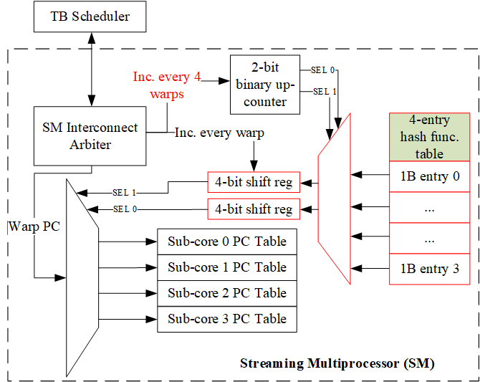
Small Hash table for Sub-Core Warp Assignment
Hardware to modify RR multiplexer for Sub-Core Assignment
We add 4-entry 1 byte-per-entry hash table
Support different programmable hashing functions
Sensitivity Study details in Paper

Slide 44
Outline
Background and Motivation
Register Bank Aware (RBA) Warp Scheduling
Hashed Sub-core Warp Assignment
Evaluation and Conclusion

Slide 45
Methodology
Simulation Methodology
Accel-Sim with GPGPU-Sim 4.0 and Volta V100 Model
112 Applications from 8 diverse benchmark suites
2 register file banks per sub-core, 8 per SM
2 CUs per sub-core, 8 per SM
RTL Power / Area Analysis of RBA vs CU scaling
Cadence Genus
Synthesized RBA and Operand Collector with 45nm PDK
SRAM modules using OpenRAM

Slide 46
Summary Design Performance

Slide 47
Summary Design Performance

Slide 48
Summary Design Performance

Slide 49
Summary Design Performance
TPC-H benchmarks benefit the most from SRR and hashed warp assignment

Slide 50
Summary Design Performance
Other applications benefit most from RBA

Slide 51
RBA improves Fully-Connected too!

Slide 52
Alternative Design Approach: Increasing # Collector Units / Sub-Core
Prevents Scheduler Issue stalls due to occupied CUs
Increases the ability to hide bank conflicts with other instructions
Collector Unit 0 (CU0)
Collector Unit 1 (CU1)
Scaling
Collector Unit 0 (CU0)
Collector Unit 1 (CU1)
Collector Unit 2 (CU1)
Collector Unit 3 (CU1)

Slide 53
Collector Unit (CU) Scaling Performance

Slide 54
Power and Area analysis of CU Scaling vs RBA

Slide 55
Conclusion
Goals
Reduce bank conflicts in partitioned SMs without costly CU scaling
Eliminate pathological sub-core issue imbalances
Design
RBA uses feedback from the operand collector stage to relieve bank conflict pressure in highly contended register file sensitive apps
Hashed sub-core assignment reduces the likelihood of sub-core issue imbalances
Key Results
Average of 11.2% speedup capturing 81% of performance lost due to SM sub-division
RBA provides equivalent performance of between 4 and 8 CUs per sub-core with only a 1% increase in normalized area and power

Slide 56
Conclusion
Goals
Reduce bank conflicts in partitioned SMs without costly CU scaling
Eliminate pathological sub-core issue imbalances
Design
RBA uses feedback from the operand collector stage to relieve bank conflict pressure in highly contended register file sensitive apps
Hashed sub-core assignment reduces the likelihood of sub-core issue imbalances
Key Results
Average of 11.2% speedup capturing 81% of performance lost due to SM sub-division
RBA provides equivalent performance of between 4 and 8 CUs per sub-core with only a 1% increase in normalized area and power

Slide 57
Conclusion
Goals
Reduce bank conflicts in partitioned SMs without costly CU scaling
Eliminate pathological sub-core issue imbalances
Design
RBA uses feedback from the operand collector stage to relieve bank conflict pressure in highly contended register file sensitive apps
Hashed sub-core assignment reduces the likelihood of sub-core issue imbalances
Key Results
Average of 11.2% speedup capturing 81% of performance lost due to SM sub-division
RBA provides equivalent performance of between 4 and 8 CUs per sub-core with only a 1% increase in normalized area and power

Slide 58
Backup Slides

Slide 59
Four Sub-Core Performance Effects
3. Warps only have access to EUs on the same sub-core
Kepler (2012)
Hopper
(2022)

Slide 60
Four Sub-Core Performance Effects
4. Lack of RF capacity on one sub-core can prevent others with capacity from accepting work
Kepler (2012)
Hopper
(2022)

Slide 61
Simulated performance as imbalance scales

Slide 62
Number of 4-byte register file reads per cycle

Slide 63
TPCH-C (top) and TPCH-U (bottom)

Slide 64
TPCH-U Coefficient of Variation of total instructions issued from each sub-core

Slide 65
Design Performance on all applications

Slide 66
Geomean speedup of compute-bound applications over 4 sub-core baseline

Slide 67
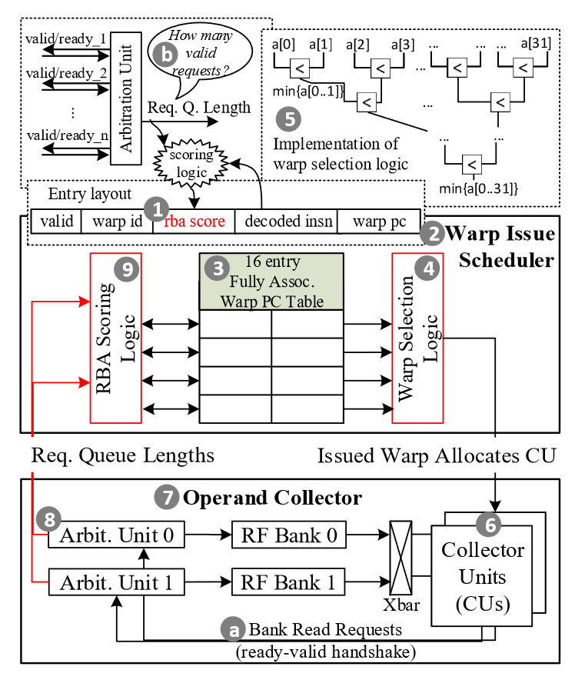
RBA Warp Scheduler
The warp scheduler selects threads to issue each cycle
Typical policies include GTO, LRR, etc.
RBA adds register file access request feedback to make better use of the limited number of CUs

